Slide 1
EETS 8355: data center network engineering
M. Scott Kingsley
CHAPTER 4: Cloud Data Center Networking Topologies

Slide 2
Chapter 4: Cloud Data Center Networking Technologies
What’s in a data center?
Compute, storage, network
Consists of:
Servers (Physical machines)
Storage
Network devices (switch, router, cables)
Power distribution systems
Cooling systems

Slide 3
Traditional multitiered enterprise networks
In this section, we will describe the cost and performance factors that are driving a change in how these data center networks are implemented and managed.
In the following sections, we will describe the various data center networking components and industry trends that are being driven in part by large cloud data center network requirements.

Slide 4
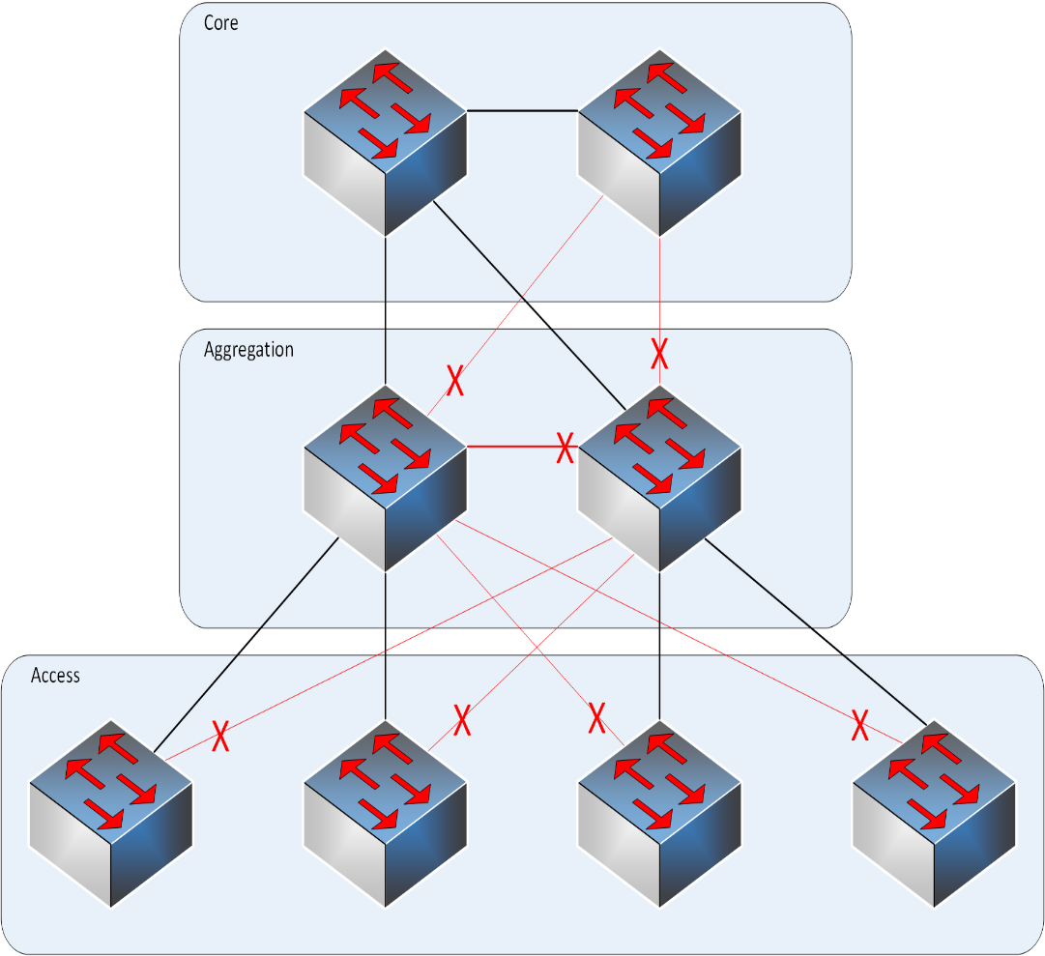
Chapter 4: Cloud Data Center Networking Technologies
Traditional three-layer switch architecture

Slide 5
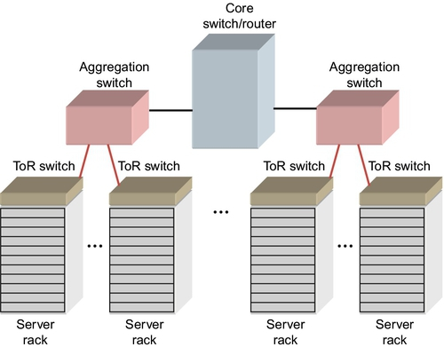
FIGURE 4.1 Traditional enterprise data center network
COST FACTORS

Slide 6
Flat data center networks
This three tiered approach adds cost, complexity, and latency in large cloud data center networks.
In addition, with the large increase we have seen in east-west data center traffic, this approach leads to high-latency variation between servers making data center performance unpredictable.

Slide 7
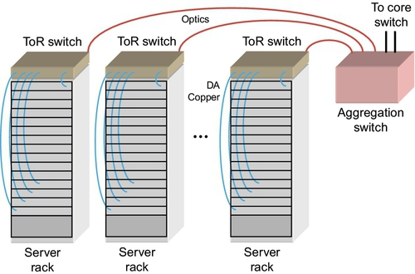
Top-of-rack (TOR) Switches
FIGURE 4.3 Top of rack switch feeding an aggregation switch.

Slide 8
Top-of-rack (TOR) Switches
The servers within the rack connect to a ToR switch using a star topology as shown in Figure 4.3.
Here, every server has a dedicated link to the ToR switch and the ToR switch may forward data to other servers in the rack, or out of the rack through high-bandwidth uplink ports.
Due to factors such as multiple VMs sharing the same network connection, 10Gb Ethernet is widely used as the link between the server shelf and the ToR switch in cloud data center networks.

Slide 9
Top-of-rack (TOR) Switches
A typical rack may contain on the order of 40 or more servers, so many ToR switches contain up to 48 10GbE ports and four 40GbE uplink ports which are connected to aggregation switches.
Although this is a 3:1 mismatch in server bandwidth (480Gbps) versus uplink bandwidth (160Gbps), data center traffic is very bursty in nature and it is rare for all the servers to be using their full allocation of 10Gbps bandwidth simultaneously.
.

Slide 10
Top-of-rack (TOR) Switches
A typical rack may contain on the order of 40 or more servers, so many ToR switches contain up to 48 10GbE ports and four 40GbE uplink ports which are connected to aggregation switches.
Although this is a 3:1 mismatch in server bandwidth (480Gbps) versus uplink bandwidth (160Gbps), data center traffic is very bursty in nature and it is rare for all the servers to be using their full allocation of 10Gbps bandwidth simultaneously.
.

Slide 11
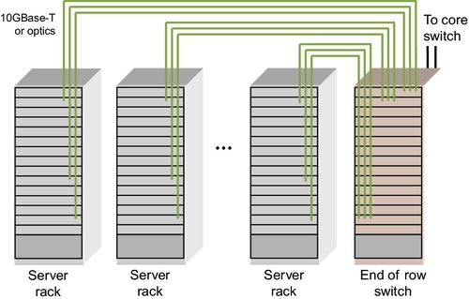
end-of-row (eor) Switches
FIGURE 4.4 Configuration of an end of row switch.

Slide 12
end-of-row (eor) Switches
By using EOR switches, costs can be reduced by eliminating separate power supplies, cooling fans, and CPU subsystems that exist in every ToR switch and aggregation switch.
Central management processors not only reduce costs, but also provide a single point of management without the need to separately manage multiple ToR switches.
In addition, cabling costs can be reduced by interconnecting the switch cards and aggregation cards together through a chassis backplane. But this comes at the cost of additional cable distance between the servers and EoR switches.

Slide 13
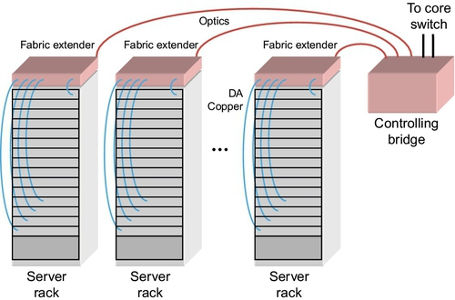
FABRIC EXTENDERS
FIGURE 4.5 Fabric extenders acting as a disaggregated end of row switch.

Slide 14
end-of-row (eor) Switches
Fabric extenders provide a unified management model while allowing the same cabling topologies used with ToR and aggregation switches.
The controlling bridge also has switch functionality which is much like the second stage spine switches in a fat-tree. Because of this, the controlling bridge is sometime referred to as a spine switch.
The entire configuration can be managed through a shared CPU control plane card in the controlling bridge, acting like a single logical EoR switch, easing configuration time and overhead.

Slide 15
AGGREGATION AND CORE SWITCHES
Aggregation switches are typically used to connect a number of ToR switches to a core switch/router.
The core switch is at the top of the cloud data center network pyramid and may include a wide area network (WAN) connection to the outside carrier network.
Because of the high-bandwidth links and high port counts of these switches, modular designs are employed with two stage fabrics either in a star or fat-tree topology..

Slide 16
AGGREGATION AND CORE SWITCHES
High-bandwidth aggregation ports are switched or routed to even higher bandwidth uplink ports. In the case of core switches, the uplink interface cards may be designed to interface directly with the carrier network and may include features such as network security and monitoring.
These are expensive systems that must meet high reliability requirements. The next section will describe these core switches in more detail.

Slide 17
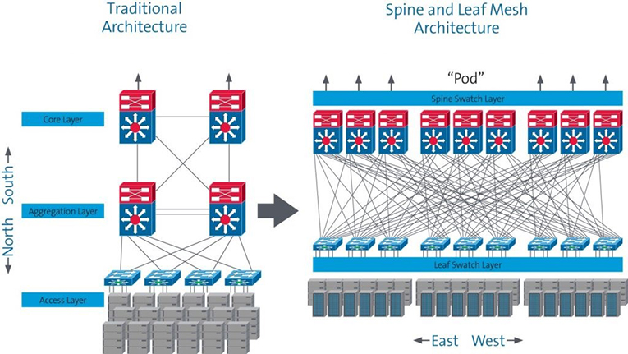
Chapter 4: Cloud Data Center Networking Technologies

Slide 18
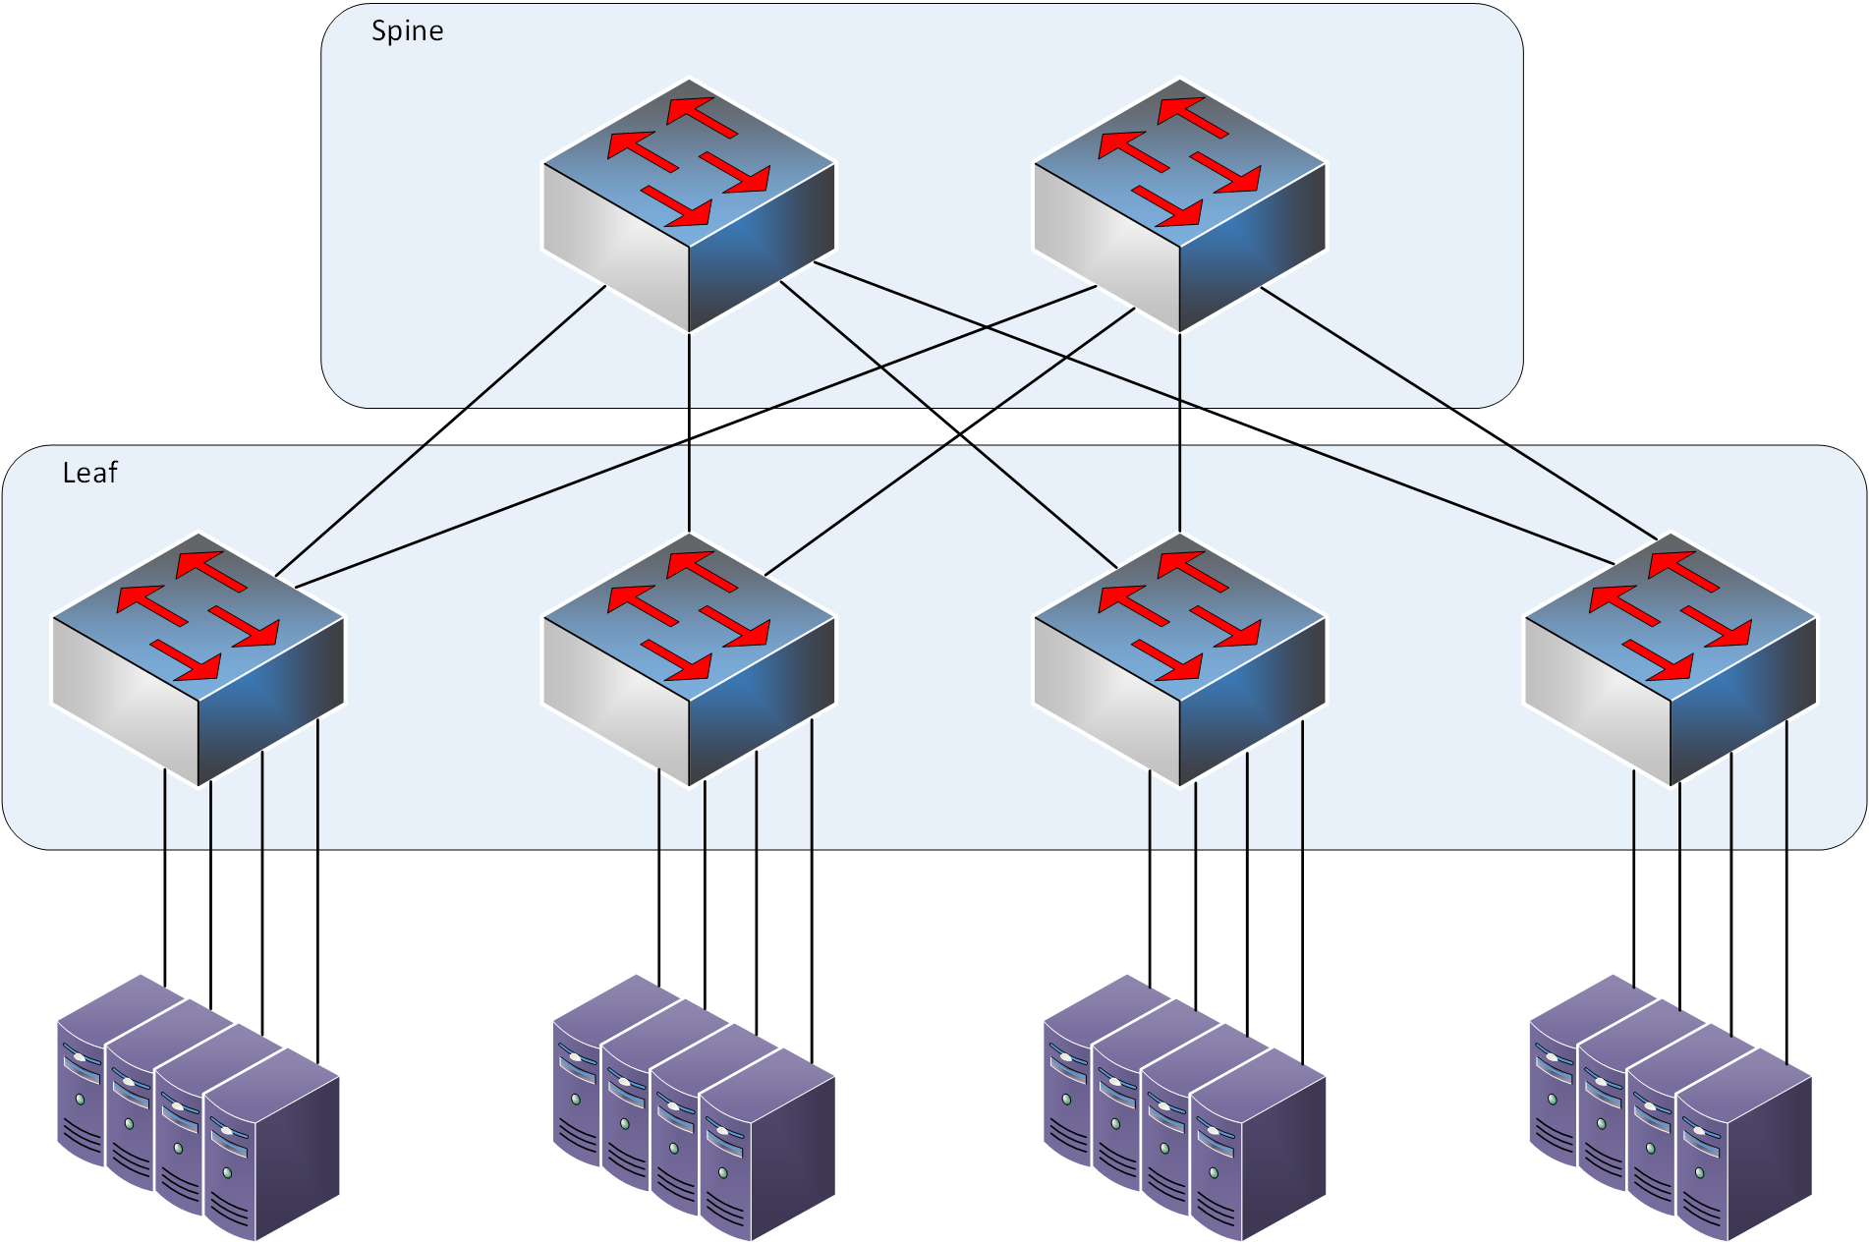
Chapter 4: Cloud Data Center Networking Technologies
“Collapsed core” two-tier architecture
“Spine and leaf”
“Folded CLOS” or “fat tree”
10x cost savings

Slide 19
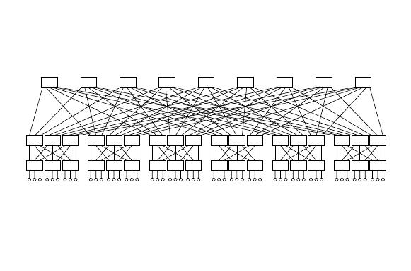
Chapter 4: Cloud Data Center Networking Technologies
Why Fat-Tree?
Fat tree has identical bandwidth at any bisections
Each layer has the same aggregated bandwidth
Can be built using cheap devices with uniform capacity
Each port supports same speed as end host
All devices can transmit at line speed if packets are distributed uniform along available paths

Slide 20
Chapter 4: Cloud Data Center Networking Technologies
Why Fat-Tree?
Fat tree has identical bandwidth at any bisections
Each layer has the same aggregated bandwidth
Can be built using cheap devices with uniform capacity
Each port supports same speed as end host
All devices can transmit at line speed if packets are distributed uniform along available paths

Slide 21
Data center network virtual switches
When data travels from a VM within a physical server through the network to another server, or to storage, or outside the datacenter, it must travel through a variety of network equipment as shown in Figure 4.1.

Slide 22
Data center network virtual switches
Data traveling to another VM within the same physical server can be routed using a virtual switch (vSwitch) within the server. Data traveling to another physical server within the same rack is routed through the vSwitch and the switch at the top of the rack.
Data traveling between racks will be further routed through an aggregation switch or end of row (EoR) switch. If this data needs to be routed to another part of the data center or to the internet, it may also travel through a data center core switch/router.

Slide 23
Data center network virtual switches
Each of these networking components requires different levels of features and performance.
This section will show where these different components are located in the network, and the features and performance required for each.

Slide 24
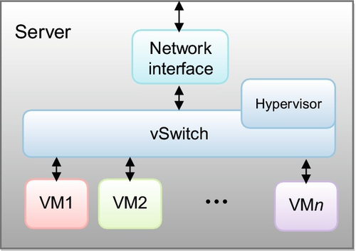
Data center network virtual switches
FIGURE 4.2 Logical diagram of a virtual switch within the server shelf.

Slide 25
Data center network virtual switches
The concept of VMs has been around for some time and allows multiple guest operating systems to run on a single physical server.
This improves data center efficiencies through higher server utilization and flexible resource allocation.
But it also increases the software complexity by requiring switching capability between these VMs using a vSwitch as shown in Figure 4.2.

Slide 26
Data center network virtual switches
In a virtualized server, the hypervisor is a program that configures and maintains both the VMs and the vSwitch.
A network interface device is used to connect the server CPU chip set to the data center network, which is usually a connection to an Ethernet ToR switch.
This device may be a network interface card (NIC) or a LAN on motherboard (LOM) device.

Slide 27
Data center network virtual switches
Virtual switching provides very high bandwidth virtual connections between VMs within the same server
But data movement in and out of the server is constrained by the network interface bandwidth. This is one reason that 10GbE is used in many of these virtualized servers.

Slide 28
Data center network virtual switches
Another factor to consider is network management.
Traditionally, data centers employ server administrators and network administrators.
Ideally, the vSwitch would be a seamless part of the overall data center network.
But in reality, the vSwitch is configured and managed by the server administrator.

Slide 29
Data center network virtual switches
This requires tight coordination between the server administrator and network administrator which can increase configuration time as well as introduce errors.
In addition, it is ideal if the vSwitch uses the same forwarding rules and capabilities that is used by all of the other equipment in the network in order to provide unified services. This is not always the case, requiring additional coordination with the physical switches.
.

Slide 30
VMWARE YOUTUBE
https://www.youtube.com/watch?v=-Hltydu9PXk

